Slide 1
Data analysis on RBI Data set
Presented By: Amol Kharat
Sandesh Jadhav
Gauri Patil
Kalpesh
Under Guidence By: Ritviz Singh

Slide 2
Content
Introduction
Objective
Mission
Plan Of Action
Result

Slide 3
Introduction
As per the Reserve Bank of India (RBI), India’s banking sector is sufficiently capitalised and well-regulated. The financial and economic conditions in the country are far superior to any other country in the world. Credit, market and liquidity risk studies suggest that Indian banks are generally resilient and have withstood the global downturn well.
Indian banking industry has recently witnessed the roll out of innovative banking models like payments and small finance banks. RBI’s new measures may go a long way in helping the restructuring of the domestic banking industry.

Slide 4
Objective
To find the releted and real data
Migrate data into Big data tools
To perform analysis using various tools.
Visualize analysis using Buisness intelligence tools.

Slide 5
Mission
To perform analysis and find important information from data set
To gain experience how analysis project does work.

Slide 6
Plan of action:
Find Data Set
Check data and convert as per requirment
Show End Result
Perform Analysis using tools

Slide 7
Tools We have used:
Python
Mysql
Hadoop
Sqoop
Tableau

Slide 8
Action:
Find the Data set:
We found RBI historical Dataset from RBI site
After that we check our data is valid or not and also a null values.

Slide 9
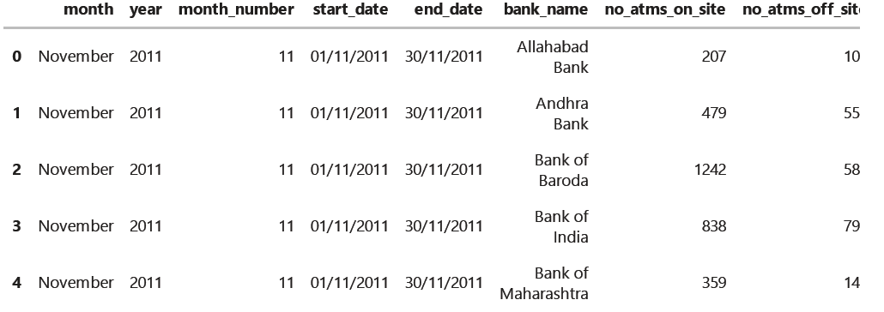
Perform EDA analysis:

Slide 10
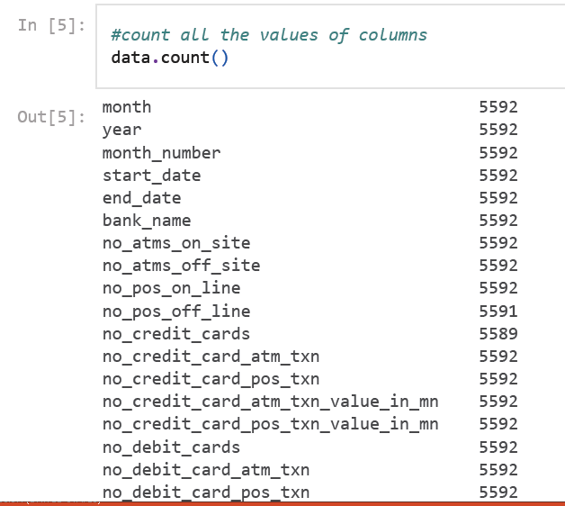
EDA:

Slide 11
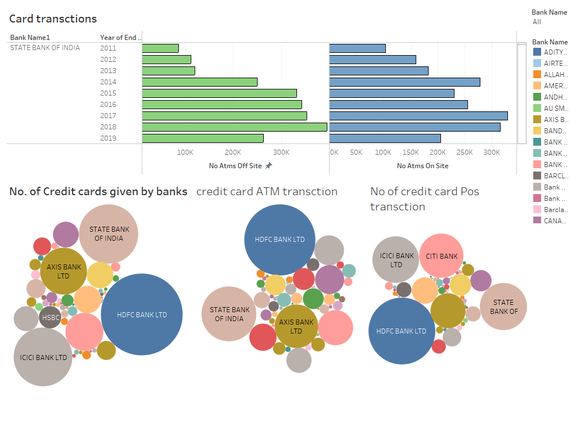
Data visualization using Tableau

Slide 12
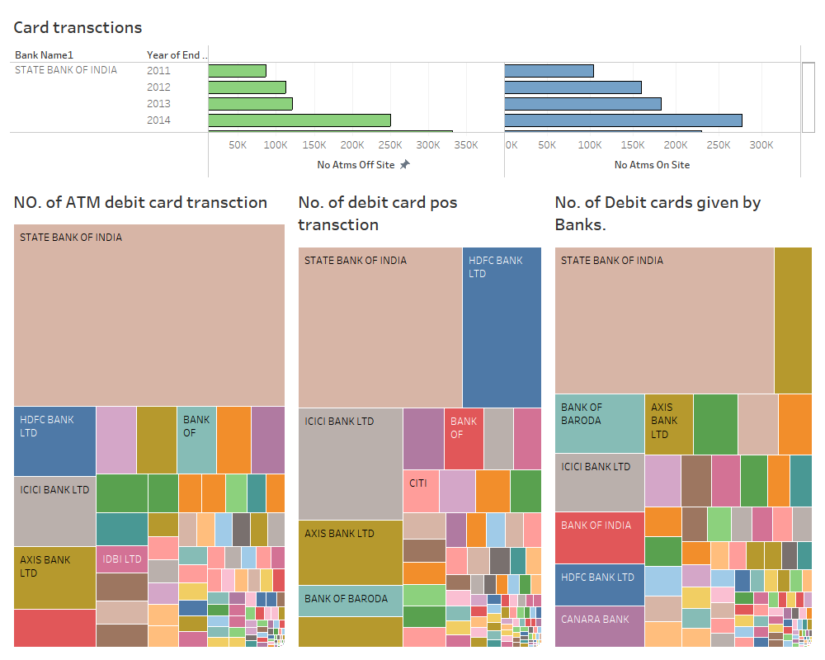

Slide 13
Conclusion
We have done our project to perform analysis and visualization on RBI data set.
Thank You All

